Slide 1

Governance and Leadership

Slide 2
Governance – What is it?
Good governance enables charities and other non-profit organisations to demonstrate transparency, accountability and how they involve key stakeholders in decision-making.
[Source: Centre for Governance and Scrutiny]
Governance is a term used to describe the trustees’ role in:
the long term direction of the charity, including its objectives or purposes
implementing policies and activities to achieve objectives
complying with legal requirements
accountability to those with an interest or 'stake' in the charity.
Good governance should happen throughout a charity. The trustee board is responsible for good governance but they rely on many different people to be able to govern well: staff, volunteers, advisors and stakeholders.
[Source: NCVO]

Slide 3
Governance – How is this implemented?
A group has a Management Committee of 7 elected members. Consisting of:
Chair
Treasurer
Secretary
etc.
Committee Members are elected by the membership on a rolling 3-year basis at the group’s Annual General Meeting in [xxxxxx]. On election to Committee, Members agree to work in the best interests of the group in accordance with their Constitution dated. All new Committee Members receive an induction.
The group recognises the importance of good governance and Committee Members are encouraged to undertake relevant training. This training is for the whole Committee on aspects of managing the group, or it may be specific training, e.g. Excel book-keeping for a newly appointed Treasurer. A record is kept of all training.
The group adheres to best practice in the management of its accounts, requiring two signatures for the authorisation of payments. The annual accounts are independently examined.
The Committee are aware of their duty of care to Members, beneficiaries and visitors and regularly review the group’s policies and practices relating to health and safety, risk and equality. The Committee will seek professional advice when required.

Slide 4
Leadership
Leadership: Every charity is headed by an effective board that provides strategic leadership in line with the charity’s aims and values.
Rationale
Strong and effective leadership helps the charity adopt an appropriate strategy for effectively delivering its aims. It also sets the tone for the charity, including its vision, values and reputation.
Key outcomes
2.1 The board, as a whole, and trustees individually, accept collective responsibility for ensuring that the charity has a clear and relevant set of aims and an appropriate strategy for achieving them.
2.2 The board agrees the charity’s vision, values and reputation and leads by example, requiring anyone representing the charity reflects its values positively.
2.3 The board makes sure that the charity’s values are reflected in all of its work, and that the ethos and culture of the organisation underpin the delivery of all activities.

Slide 5
Governance
TASK:
In groups please discuss what makes good governance – what is your experience of Boards/Trustees/Management Committees - examples of good practice, what is the purpose of having governors/trustees, should the board be clear about the charity’s aims and how do they ensure that these are being delivered effectively and sustainably?

Slide 6
Feedback

Slide 7
HOW DO YOU SOURCE TRUSTEES?

Slide 8
Re:Purpose
Re:Purpose is an initiative that matches senior executive volunteers with small charities, community projects and social enterprises in urgent need of strategic support.
The impact of COVID 19 has put huge pressure on our UK Charities and if we don’t act now a lifeline for some people in our communities could be lost forever.
Small, grass roots charities, traditionally underfunded, under resourced and operating within tight budgets, are now stretched beyond capacity and in real danger of closing their doors for good.

Slide 9

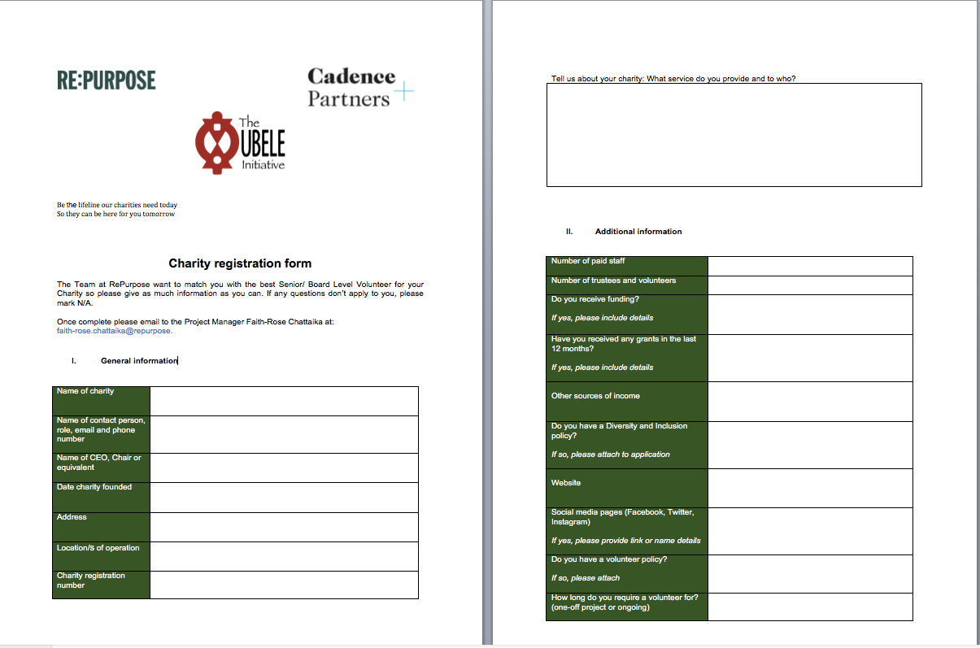
Resources

Slide 10
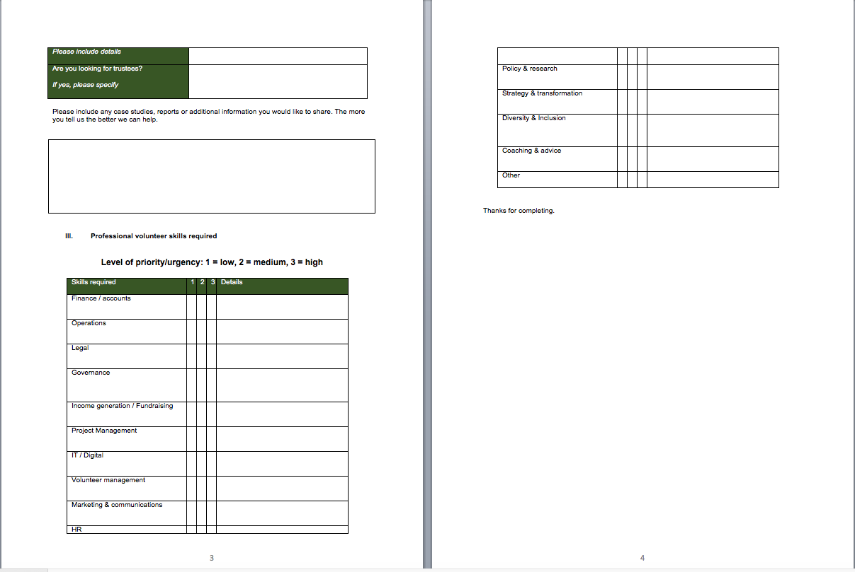
Committee members
How to source them

Slide 11
Trustees
Trustees have to:
Act in your charity’s best interest
Manage the charity’s resources responsibly
Act with reasonable care and skill
Deal with conflicts of interest
Implement financial controls
Manage risks
Take appropriate advice when you need to, for example when buying or selling land, or investing
Charity Commission for England and Wales

Slide 12
Skills Audit of Trustees

Slide 13
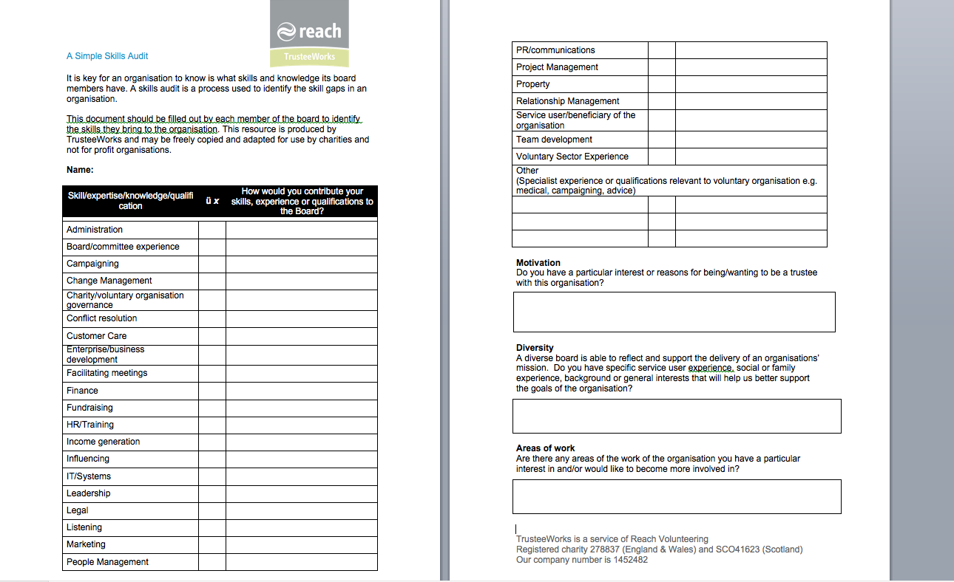
Q&A

Slide 14


Slide 15
Resources
Ubele:
https://www.ubele.org
How to recruit Trustees for your charity:
https://0ab75ddf-ffbf-4afe-a23e-a40ac25808f2.filesusr.com/ugd/5c57a6_d16407fb797641d1aa08977130920c12.pdf
Do-It
https://do-it.org/
Small Charities Coalition:
http://www.smallcharities.org.uk/
Re-Purpose
http://repurpose.org.uk/
Charities Excellence Framework:
https://www.charityexcellence.co.uk/
NCVO:
https://www.ncvo.org.uk/
The Essential Trustee:
https://www.gov.uk/government/publications/the-essential-trustee-what-you-need-to-know-cc3

Slide 16


